Slide 1
Data Collection and Getting Data into AWS

Slide 2
Agenda
Direct Connect
Snowball
Snowball Edge
Snowmobile
Database Migration Service
Data Pipeline
Lambda
API Gateway and CloudFront

Slide 3
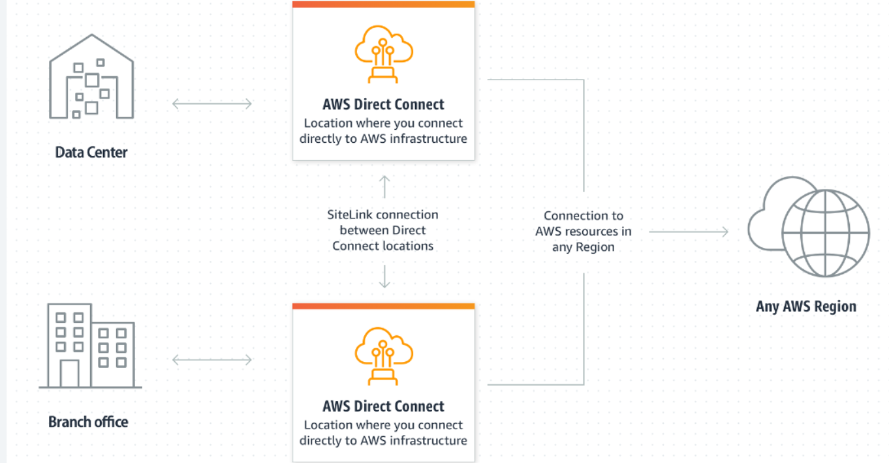
Direct Connect
The cloud service AWS DirectConnect is the shortest path to AWS resources.
During the transfer, network traffic stays on the global AWS network and does not access the public Internet.
When you create a new connection, you can choose a hosted connection provided by your AWS Direct Connect deployment partner, or you can choose a dedicated connection from AWS to deploy to over 100 AWS Direct Connect locations around the world.
AWS Direct Connect SiteLink allows you to send data between AWS Direct Connect sites to create a private network connection between offices and data centers in your global network.
Credit: https://aws.amazon.com/directconnect/
Notes:
Reference for contents: https://aws.amazon.com/directconnect/
More explanation:

Slide 4
AWS Direct Connect features
AWS Direct Connect Locations Worldwide :
AWS Direct Connect is available in locations around the world, allowing you to establish a connection near where you need it.
In some places, some AWS DirectConnect features such as MACsec and 100Gbps connectivity are available.
More Than 100 MBPS Speed:
AWS Direct Connect is to be had in speeds beginning at 50 Mbps and scaling as much as one hundred Gbps, so that you can discover the proper connection for you.
MACsec and IPsec Encryption options:
Use multiple encryption options to further protect communication between data centers, branch offices, or colocation facilities.
Protects 10Gbps and 100Gbps connections using native point-to-point IEEE 802.1AE (MACsec) encryption at selected locations.
AWS SitetoSite VPN can also be used for secure connections using IPsec (IP security).
Notes:
Reference for contents: https://aws.amazon.com/directconnect/
More explanation:

Slide 5
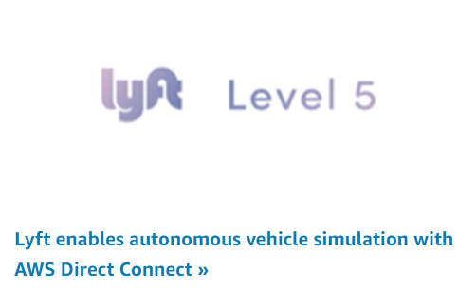
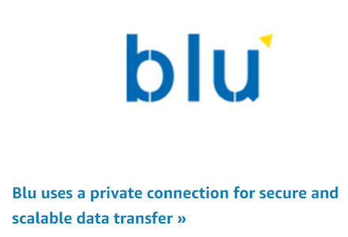
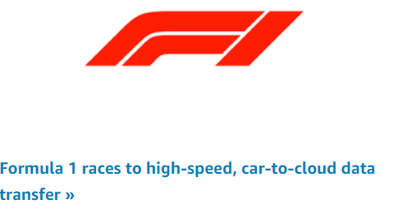
Use Cases
Building hybrid connection: Link AWS with your on-premises network to build cross-environmental applications without sacrificing performance.
Extend your existing network: Once you connect your network to AWS DirectConnect, you can use SiteLink to send data between locations. When using SiteLink, data is sent between sites using the shortest route.
Manage large datasets: Ensures large, smooth and reliable data transfer for real-time analytics, fast backups, or broadcast media processing.
Credit: https://aws.amazon.com/directconnect/
Notes:
Reference for contents: https://aws.amazon.com/directconnect/
More explanation:

Slide 6
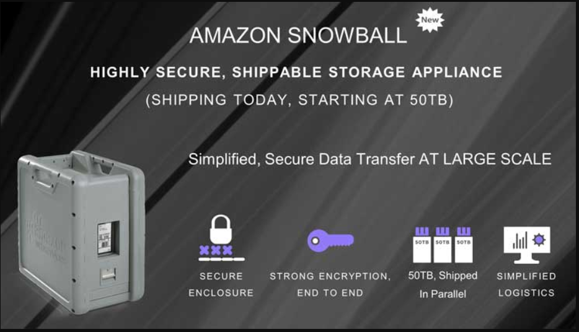
AWS Snowball
It is a part of AWS Snow Family.
It is used for edge storage, edge computing and data migration device.
This device is also utilized for data processing, machine learning and data collection.
Snowball supports specific Amazon EC2 instance types and AWS Lambda functions, so you can develop and test in the AWS cloud, then deploy applications to remote devices for collection, processing preprocess and send the data to AWS.
Use cases: data migration, data transport, image collation, IoT sensor stream capture, and machine learning.
Credit: https://aws.amazon.com/snowball/?whats-new-cards.sort-by=item.additionalFields.postDateTime&whats-new-cards.sort-order=desc
Notes:
Reference for contents: : https://aws.amazon.com/snowball/?whats-new-cards.sort-by=item.additionalFields.postDateTime&whats-new-cards.sort-order=desc
More explanation:

Slide 7
Benefits of AWS Snowball
Scalable
Secure and Durable
High speed
Flexible data recovery
Simple and Compatible
Economical
Secure Transfer
Easy data movement
Process data locally
Analyze data locally
Stand-alone storage
Notes:
Reference for contents: : https://aws.amazon.com/snowball/?whats-new-cards.sort-by=item.additionalFields.postDateTime&whats-new-cards.sort-order=desc
More explanation:

Slide 8
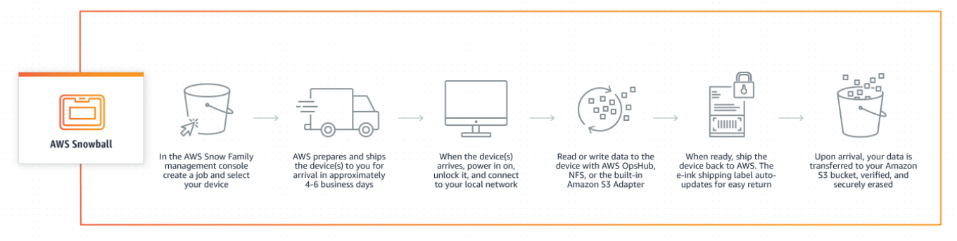
How Does AWS Snowball Works
From the AWS Snow Family console, Device is chosen, Optimized Snowball Edge Storage is computed.
Jobs are created using Amazon S3 bucket
select Amazon Simple Notification Service (Amazon SNS) to monitor and configure options like Amazon EC2 AMI and GPU.
Data is transferred after that or EC2 is launched.
Once the device arrives in the AWS Region, all data stored in your integration bucket(s) will be moved to your S3 bucket and verified the same time you upload the device.
All data is then securely erased from the device and all customer information is also deleted.
Credit: https://aws.amazon.com/snowball/?whats-new-cards.sort-by=item.additionalFields.postDateTime&whats-new-cards.sort-order=desc
Notes:
Reference for contents: : https://aws.amazon.com/snowball/?whats-new-cards.sort-by=item.additionalFields.postDateTime&whats-new-cards.sort-order=desc
More explanation:

Slide 9
Features of AWS Snowball
Fast data transfer
AWS OpsHub for simple data management and monitoring
GPU support
Clustering
S3-Compatible endpoint for object storage
Block storage
NFS endpoint
Encryption
Rugged and portable
Tamper Evident
Secure erasure
Notes:
Reference for contents: : https://aws.amazon.com/snowball/?whats-new-cards.sort-by=item.additionalFields.postDateTime&whats-new-cards.sort-order=desc
More explanation:

Slide 10
Snowball Edge
AWS Snowball Edge is a type of Snowball appliance with built-in compute and storage for certain AWS features.
Snowball Edge can perform local processing and edge computing workloads in addition to transferring data between your local environment and the AWS cloud.
Any Snowball Edge device can transfer data at faster speeds than the Internet.
This transport is done by transporting the data to the devices through a service provider in the area.
The devices are designed to be sturdy, with the E Ink shipping label.
The device next to Snowball has three options for optimized device storage configurations, optimization calculations and optimization calculations with GPUs.
When this tutorial refers to the device next to Snowball, it is about the introduction of all the device's options.
When specific information only applies to one or more optional device configuration (such as snowball with GPU with GPU on board), it is specially called.
Notes:
Reference for contents: https://docs.aws.amazon.com/snowball/latest/developer-guide/whatisedge.html
More Explanation:

Slide 11
Features of Snowball Edge
Massive amount of storage or compute functionality for devices.
Network adapter with transfer rates up to 100 Gbps. Encryption is enforced, protecting your data at rest and in transit.
You can import or export data between your on-premises environment and Amazon S3, and physically transport the data to one or more devices without using the Internet.
Snowball Edge devices have their own rugged exterior. The built-in E Ink display changes to show your shipping labels when the device is ready to ship.
The Snowball Edge device has a built-in LCD display that can be used to manage network connections and receive service status information.
You can group Snowball Edge devices for local storage and compute tasks to provide data endurance across 5-10 devices and scale local storage as required.
Notes:
Reference for contents: https://docs.aws.amazon.com/snowball/latest/developer-guide/whatisedge.html
More Explanation:

Slide 12
AWS Snowmobile
AWS Snowmobile is an Exabyte-scale facts switch carrier used to transport extraordinarily huge quantities of facts to AWS.
You can switch as much as 100PB consistent with Snowmobile, a 45-foot lengthy ruggedized delivery container, pulled via way of means of a semi-trailer truck.
Snowmobile makes it clean to transport huge volumes of facts to the cloud, along with video libraries, photo repositories, or maybe a whole facts middle migration.
Transferring facts with Snowmobile is extra secure, rapid and fee effective.
After the initial assessment, It will be shipped to your data center and AWS staff will configure it for you to access as a network storage target.
Once your Snowmobile is onsite, AWS staff will work with your team to connect the Snowmobile's detachable high-speed switch to your local network and you're good to go high-speed data transfer from any source in your data center to Snowmobile.
Once your data is uploaded, Snowmobile is sent back to AWS, where your data is imported into Amazon S3.
It helps to protect data.
Notes:
Reference for contents: https://aws.amazon.com/snowmobile/
More Explanation:

Slide 13
Benefits of Snowmobile
Rapid large-scale transmission - even a high-speed Internet connection can take decades to transfer huge volumes of data. A sled, on the other hand, can transfer up to 100 PB of data in a matter of weeks. The same data transfer, moved by a 1 Gbps connection, will take more than 20 years.
Safe encryption - All data is written on an encrypted sleigh with 256 bit encryption. You can handle encryption keys with AWS KMS. Remember that Snowmobile hardware never burns and securely cleaning buttons in case of power outages.
Durable, Durable And High Security: The snowmobile is designed to be temperature controlled, water resistant and tamper-proof. Only AWS employees can operate the device, and there are strict physical, hardware, and software access controls in place. The snowmobile is tracked by GPS and has 24-hour video surveillance. AWS offers an optional security vehicle escort service while the sled is in transit.
Customization: AWS is compatible with almost every physical data center facility. AWS is available to work with in-house teams to ensure that all requirements are met before any Snowmobile arrives.
Notes:
Reference for contents: https://aws.amazon.com/snowmobile/
More Explanation:

Slide 14
Snowmobile Jobs
Site survey: AWS personnel work with the organization to understand its migration goals. They evaluate many aspects, including your physical data center and available network configuration. The goal is to help Snowmobile customers determine a migration plan.
Site preparation: Snowmobile customers are encouraged to identify and prepare the local resources needed for the job. Your data center staff is responsible for preparing everything needed to accept Snowmobile vehicles, including parking, power, rack space, local security, gateways, and network addresses.
Shipping and setup: AWS staff send the sleds to the site. Upon arrival, AWS staff configure Snowmobiles in your data center so that local resources can safely transfer data there.
Return and Download: Once all data has been copied, the vehicle is returned to the AWS Region you specified in your snowmobile order. The data is then loaded into the requested AWS storage service.
Notes:
Reference for contents: https://aws.amazon.com/snowmobile/
More Explanation:

Slide 15
Database Migration Service
The AWS Database Migration Service (AWS DMS) helps you quickly and securely migrate your databases to AWS.
The source database remains fully operational during the migration, minimizing downtime for database-dependent applications.
The AWS Database Migration Service can migrate your data to and from the most widely used commercial and open source databases.
The AWS Database Migration Service supports uniform migrations such as Oracle to Oracle.
With the AWS Database Migration Service, you can also seamlessly replicate data with low latency from any supported source to any supported target.
Notes:
Reference for contents: https://aws.amazon.com/dms/
More Explanation:

Slide 16
Benefits of Database Migration Service
Cost reduction
Agility and staff productivity
Security and resilience
Data centre consolidation
Simple to use
Minimal downtime
Supports widely used database
On-going replication
Reliable
Notes:
Reference for contents: https://aws.amazon.com/dms/
More Explanation:

Slide 17
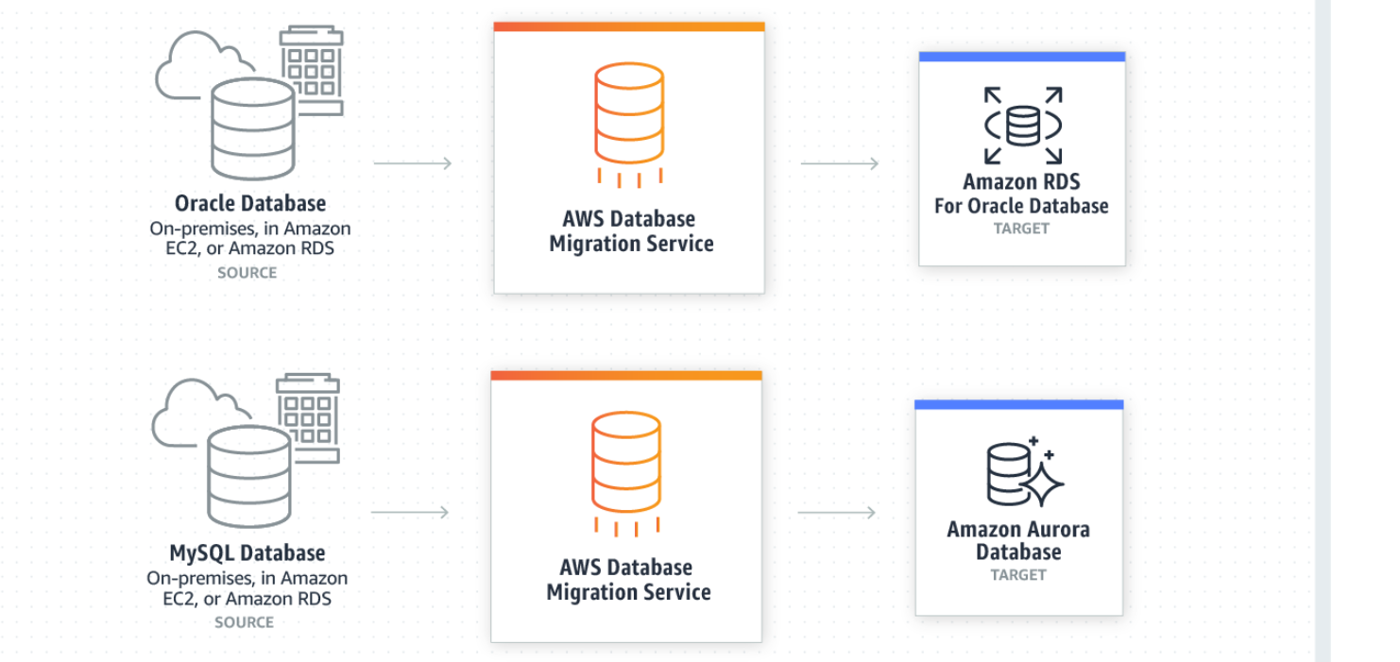
Homogeneous Database Migrations
In homogeneous database migration, the source database engine and the target database engine are from Amazon RDS for MySQL, or Microsoft SQL Server to Amazon RDS for SQL Server.
Since the schema structure, data types, and database code are compatible between the source and target database.
This type of migration is an ONEREP process because schema structure, data type, data type, and database code are compatible between source and destination databases.
Create a migration task with a connection to the source database and destination database, and click the button to start migration.
AWS Database Migration Services see the remaining troublesome.
Source databases can be placed in their own unique facility outside the AWS.
Credit: https://aws.amazon.com/dms/
Notes:
Reference for contents: https://aws.amazon.com/dms/
More Explanation:

Slide 18
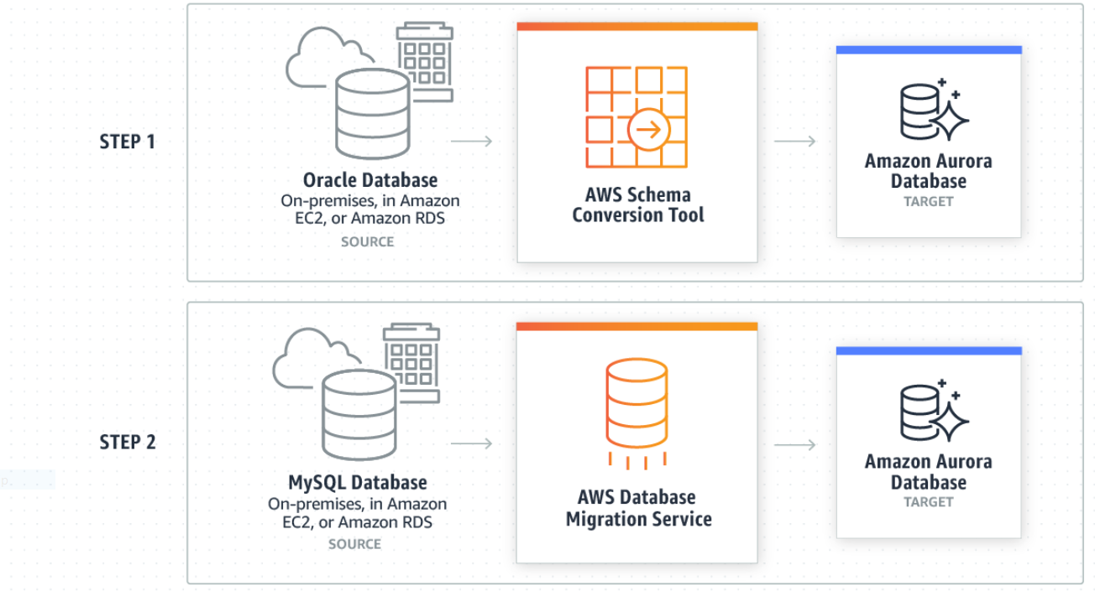
Heterogeneous Database Migrations
When migrating a heterogeneous database, the source and target database engines are different.
Heterogeneous migration is a two-step process.
First, use the AWS Schema Conversion Tool to convert the source schema and code to match those in your target database.
Then use the AWS Database Migration Service to migrate the data from the source database to the target database.
All required data types are automatically converted during the migration.
The source database is located in its own facility outside of AWS and may be running on an Amazon EC2 instance or it may be an Amazon RDS database.
The destination can be an Amazon EC2 or Amazon RDS database.
Notes:
Reference for contents: https://aws.amazon.com/dms/
More Explanation:

Slide 19
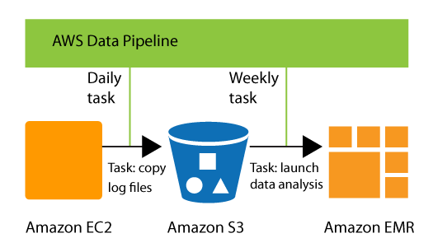
Introduction to AWS Data Pipeline
The AWS Data Pipeline web service allows you to automate data transportation and transformation.
You can design data-driven workflows with AWS Data Pipeline, so that tasks are contingent on the accomplishment of preceding activities.
AWS Data Pipeline enforces the logic you've set up by defining the parameters of your data transformations.
You can, for example, use AWS Data Pipeline to daily record your web server's logs to Amazon Simple Storage Service (Amazon S3), and then execute a weekly Amazon EMR (Amazon EMR) cluster over those logs to obtain traffic metrics.
Credit: https://docs.aws.amazon.com/datapipeline/latest/DeveloperGuide/what-is-datapipeline.html
Notes:
Reference for contents:
https://docs.aws.amazon.com/datapipeline/latest/DeveloperGuide/what-is-datapipeline.html
More Explanation:
AWS Data Pipeline provides two distinct sets of features. Create a pipeline using the first set by defining data sources, schedules, dependencies, and the data transforms to be executed.
AWS Data Pipeline creates and manages a pipeline, which is a data-driven operation. AWS Data Pipeline takes care of the scheduling and ensuring that data dependencies are met, allowing your application to focus on data processing.
AWS Data Pipeline Task Runner is a JAR implementation of a task runner provided by AWS Data Pipeline. The AWS Data Pipeline Task Runner provides logic for common data management scenarios like database queries and Amazon Elastic MapReduce data analysis (Amazon EMR). You have the option of using AWS Data Pipeline Task Runner or writing your own task runner to provide bespoke data management.
AWS Data Pipeline provides two distinct sets of features. Create a pipeline using the first set by defining data sources, schedules, dependencies, and the data transforms to be executed. To obtain the next task ready for processing, use the second set in your task runner programme. The task runner contains the logic for doing the task, such as querying the data, running data analysis, or transforming data from one format to another. The task runner completes the task that the web service has assigned to it, while also reporting its progress to the web service. When the task is completed, the task runner informs the web service of the task's final success or failure.

Slide 20
Features of AWS Data Pipeline
Reliable
Easy to Use
Flexible
Scalable
Low Cost
Transparent
Notes:
Reference for contents:
https://aws.amazon.com/datapipeline/
More Explanation:
Reliable: AWS Data Pipeline is built on a distributed, highly available infrastructure that ensures your actions are executed in a fault-tolerant manner. If your activity logic or data sources fail, AWS Data Pipeline retries the activity automatically.
Easy to Use: Using our drag-and-drop console, you can quickly and easily create a pipeline. You don't need to add any extra logic to use common preconditions because they're integrated into the service.
Flexible: You may use AWS Data Pipeline to take advantage of capabilities like scheduling, dependency tracking, and error handling. You can use AWS-provided activities and preconditions or create your own custom ones.
Scalable: AWS Data Pipeline makes it simple to distribute work to a single machine or a group of machines, either serial or parallel. Processing a million files is as simple as processing a single file using AWS Data Pipeline's flexible design.
Low Cost: AWS Data Pipeline is a low-cost service that is invoiced on a monthly basis. You can use it for free as part of the AWS Free Usage programme.
Transparent: You have complete control over the computing resources used to run your business logic, making it simple to improve and troubleshoot it. Additionally, full execution logs are sent to Amazon S3, providing you with a permanent, detailed record of what happened in your pipeline.

Slide 21
Process Handled by AWS Data Pipeline
Your jobs' scheduling, execution, and retry logic.
Keeping track of the dependencies between your business logic, data sources, and earlier processing steps so that your logic doesn't run until all of its dependencies are met.
Sending any necessary failure notifications.
Creating and managing any compute resources your jobs may require.
Notes:
Reference for contents:
https://aws.amazon.com/datapipeline/details/
More Explanation:

Slide 22
Popular AWS Data Pipeline Usecases
ETL Data to Amazon Redshift
ETL Unstructured Data
Load AWS Log Data to Amazon Redshift
Data Loads and Extracts
Move to Cloud
Amazon DynamoDB Backup and Recovery
Notes:
Reference for contents:
https://aws.amazon.com/datapipeline/details/
More Explanation:
ETL Data to Amazon Redshift: Copy RDS or DynamoDB tables to S3, alter the data format, execute SQL queries for analytics, and then put it into Redshift.
ETL Unstructured Data: Use Hive or Pig on EMR to analyse unstructured data such as clickstream logs, then combine it with structured data from RDS and send it to Redshift for easy querying.
Load AWS Log Data to Amazon Redshift: Load log files from Amazon S3 to Redshift, such as AWS billing logs, AWS CloudTrail, Amazon CloudFront, and Amazon CloudWatch logs.
Data Loads and Extracts: Copy data from your RDS or Redshift table to S3 and vice-versa.
Move to Cloud: Copy data from an on-premises data storage, such as a MySQL database, to an AWS data store, such as S3, to make it available to AWS services like Amazon EMR, Amazon Redshift, and Amazon RDS.
Amazon DynamoDB Backup and Recovery: Periodically backup your Dynamo DB table to S3 for disaster recovery purposes.

Slide 23
Methods to Interface With AWS Data Pipeline
AWS Management Console
AWS Command Line Interface (AWS CLI)
AWS SDKs
Query API
Notes:
Reference for contents:
https://docs.aws.amazon.com/datapipeline/latest/DeveloperGuide/what-is-datapipeline.html
More Explanation:
AWS Management Console: Provides a web interface that you can use to access AWS Data Pipeline.
AWS Command Line Interface (AWS CLI): Provides commands for a broad set of AWS services, including AWS Data Pipeline, and is supported on Windows, macOS, and Linux.
AWS SDKs: Provides language-specific APIs and takes care of many of the connection details, such as calculating signatures, handling request retries, and error handling.
Query API: Provides language-specific APIs and handles many of the connection intricacies, such as calculating signatures, retrying requests, and resolving errors.

Slide 24
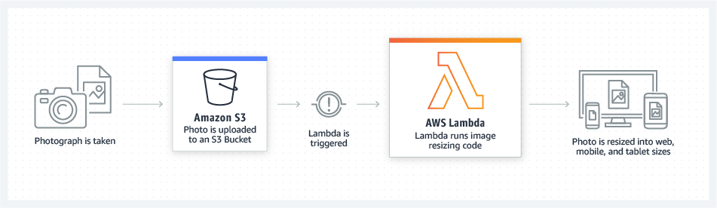
Introduction to AWS Lambda
AWS Lambda is a serverless, event-driven computing solution that allows you to run code for almost any form of application or backend service without having to provision or manage servers.
AWS services for managing APIs, messaging, storage, and content distribution can all be used in serverless applications. Lambda is used by the majority of these apps to connect these services and alter data throughout the application.
Credit: https://aws.amazon.com/lambda/
Notes:
Reference for contents:
https://docs.aws.amazon.com/lambda/latest/dg/welcome.html
More Explanation:
Lambda-based apps are event-driven designs with a lot of distributed system features.

Slide 25
Features of AWS Lambda
Extend other AWS services with custom logic
Build custom backend services
Bring your own code
Completely automated administration
Built-in fault tolerance
Automatic scaling
Only pay for what you use
Integrated security model
Notes:
Reference for contents:
https://aws.amazon.com/lambda/features/
More Explanation:
Extend other AWS services with custom logic: AWS Lambda lets you add custom logic to AWS resources like Amazon S3 buckets and Amazon DynamoDB tables, allowing you to quickly compute data as it enters or moves through the cloud.
Build custom backend services: Using the Lambda application programming interface (API) or custom API endpoints established using Amazon API Gateway, you can create new backend application services that are activated on demand. Instead of serving custom events on the client, Lambda processes them, allowing you to eliminate platform variances, save battery drain, and make updates easier.
Bring your own code: There are no new languages, tools, or frameworks to learn with AWS Lambda. Any third-party library, including native ones, can be used. You may also use Lambda Layers to package any code (frameworks, SDKs, libraries, and more) and manage and share it across many functions. Lambda supports Java, Go, PowerShell, Node.js, C#, Python, and Ruby code natively, as well as a Runtime API that allows you to write your functions in any other programming language.
Completely automated administration: AWS Lambda manages all the infrastructure to run your code on highly available, fault tolerant infrastructure, freeing you to focus on building differentiated backend services.
Built-in fault tolerance: AWS Lambda is designed to provide high availability for both the service itself and the functions it operates. There are no maintenance windows or scheduled downtimes.
Automatic scaling: AWS Lambda runs your code just when it's needed, and it scales automatically to handle the volume of incoming requests without requiring any manual configuration.
Only pay for what you use: You pay for execution time rather than server units using AWS Lambda. You only pay for requests served and the compute time required to run your code when you use Lambda functions.
Integrated security model: The built-in SDK for AWS Lambda interfaces with AWS Identity and Access Management (IAM) to provide safe code access to other AWS services.

Slide 26
Usecases of AWS Lambda
Web applications
Web and mobile backends
Data processing
Parallelized computing tasks
Internet of Things (IoT) workloads
Notes:
Reference for contents:
https://docs.aws.amazon.com/lambda/latest/operatorguide/intro.html
More Explanation:
Web applications: serve the front-end code via Amazon S3 and Amazon CloudFront, or automating the entire deployment and hosting with AWS Amplify Console.
Web and mobile backends: the front-ends interact with the backend via API Gateway. Integrated authorization and authentication are provided by Amazon Cognito or APN Partners like Auth0.
Data processing: event-based processing tasks triggered by data changes in data stores, or streaming data ETL tasks with Amazon Kinesis and Lambda.
Parallelized computing tasks: splitting highly complex, long-lived computations to individual tasks across many Lambda function instances to process data more quickly in parallel.
Internet of Things (IoT) workloads: processing data generated by physical IoT devices.

Slide 27
Interfaces of AWS Lambda
AWS Management Console
AWS Command Line Interface (AWS CLI)
AWS SDKs
AWS CloudFormation
AWS Serverless Application Model (AWS SAM)
Notes:
Reference for contents:
https://docs.aws.amazon.com/lambda/latest/dg/welcome.html
More Explanation:
AWS Management Console — Allows you to access your functions via a web interface.
AWS Command Line Interface (AWS CLI) — Supports Windows, macOS, and Linux and provides commands for a wide range of AWS services, including Lambda.
AWS SDKs — Provide language-specific APIs and handle numerous connection intricacies including signature computation, request retry handling, and error handling.
AWS CloudFormation — Allows you to define your Lambda apps using templates. The AWS Cloud Development Kit is also supported by AWS CloudFormation (CDK)
AWS Serverless Application Model (AWS SAM) — This model provides templates and a command line interface for configuring and managing AWS serverless applications.

Slide 28
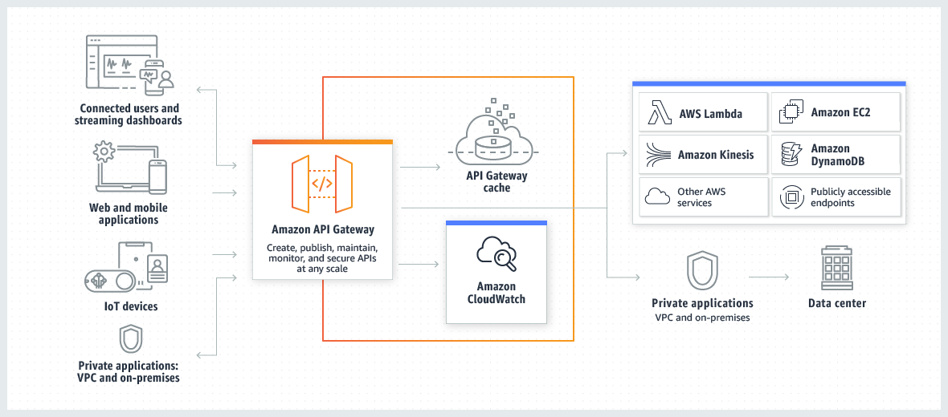
Introduction to AWS API Gateway
The Amazon API Gateway service allows you to create, publish, maintain, monitor, and secure REST, HTTP, and WebSocket APIs at any scale.
API developers can design APIs that access AWS or other online services, as well as AWS Cloud data.
You can construct APIs for usage in your own client applications as an API Gateway API developer.
Credit:https://docs.aws.amazon.com/apigateway/latest/developerguide/welcome.html
Notes:
Reference for contents:
https://docs.aws.amazon.com/apigateway/latest/developerguide/welcome.html
More Explanation:
You can make your APIs available to third-party app developers.
API Gateway serves as a "front door" for applications to access data, business logic, or functionality from your backend services, such as Amazon Elastic Compute Cloud (Amazon EC2) workloads, AWS Lambda code, any web site, or real-time communication applications.

Slide 29
Features of AWS API Gateway
Support for RESTful APIs and WebSocket APIs
Private integrations with AWS ELB & AWS Cloud Map
Resiliency
Easy API Creation and Deployment
API Operations Monitoring
AWS Authorization
API Keys for Third-Party Developers
SDK Generation
API Lifecycle Management
Notes:
Reference for contents:
https://aws.amazon.com/api-gateway/features/
More Explanation:
Support for RESTful APIs and WebSocket APIs: With API Gateway, you can create RESTful APIs using either HTTP APIs or REST APIs.
Private integrations with AWS ELB & AWS Cloud Map: Requests can be routed to private resources in your VPC using API Gateway. APIs for services behind private ALBs, private NLBs, and IP-based services registered in AWS Cloud Map, such as ECS tasks, can be built using HTTP APIs.
Resiliency: API Gateway allows you to create throttling rules depending on the number of requests per second for each HTTP method in your APIs, which helps you manage traffic to your backend services.
Easy API Creation and Deployment: You may quickly and easily construct a custom API to your AWS Lambda code and then call the Lambda code from your API using API Gateway.
API Operations Monitoring: API Gateway offers you with a dashboard to visually monitor calls to the services when an API is deployed and in use.
AWS Authorization: API Gateway can enable you use signature version 4 for REST APIs and WebSocket APIs to authorise and validate API calls to AWS services.
API Keys for Third-Party Developers: API Gateway helps you manage the ecosystem of third-party developers who access your REST APIs if you're using them.
SDK Generation: API Gateway can build client SDKs for a variety of platforms that you may use to quickly test new APIs from your applications and distribute SDKs to third-party developers if you're utilising REST APIs.
API Lifecycle Management: API Gateway allows you to operate many versions of the same REST API at the same time, allowing apps to call earlier API versions even after the latest versions are released.

Slide 30
Usecases of AWS API Gateway
API Gateway to create HTTP APIs
API Gateway to create REST APIs
API Gateway to create WebSocket APIs
Notes:
Reference for contents:
https://docs.aws.amazon.com/apigateway/latest/developerguide/api-gateway-overview-developer-experience.html
More Explanation:
API Gateway to create HTTP APIs: HTTP APIs enable you to create RESTful APIs with lower latency and lower cost than REST APIs.
API Gateway to create REST APIs: Resources and methods make up an API Gateway REST API. A resource is a logical entity that a resource path allows an app to access. A method relates to a REST API request made by a user of your API and the response that is returned to the user.
API Gateway to create WebSocket APIs: Both the client and the server can send messages to each other at any moment under a WebSocket API. Without the need for sophisticated polling systems, backend servers can easily transfer data to connected users and devices.

Slide 31
Interfaces for Accessing AWS API Gateway
AWS Management Console
AWS SDKs
API Gateway V1 and V2 APIs
AWS Command Line Interface
AWS Tools for Windows PowerShell
Notes:
Reference for contents:
https://docs.aws.amazon.com/apigateway/latest/developerguide/api-gateway-overview-developer-experience.html
More Explanation:
AWS Management Console: The AWS Management Console is a web interface that allows you to create and manage APIs.
AWS SDKs: You can use an SDK to access API Gateway if you're using a programming language for which AWS has an SDK. SDKs make authentication easier, interact with your development environment more readily, and give you access to API Gateway operations.

Slide 32
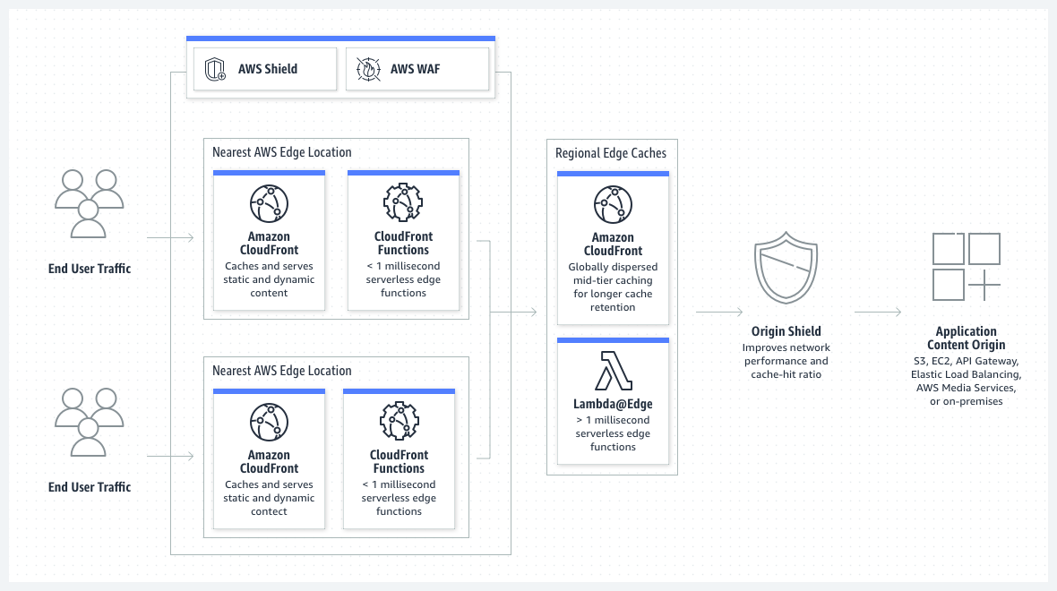
Introduction to CloudFront
Amazon CloudFront is a web service that accelerates the delivery of static and dynamic web content to your users, such as.html,.css,.js, and picture files.
CloudFront distributes your content over a global network of data centres known as edge locations.
When a user requests content served by CloudFront, the request is routed to the edge location with the lowest latency (time delay), ensuring that the content is provided as quickly as feasible.
Credit: https://aws.amazon.com/cloudfront/
Notes:
Reference for contents:
https://aws.amazon.com/cloudfront/
More Explanation:

Slide 33
Features of CloudFront
Global Edge Network
Security
Availability
Edge Computing
Real-time Metrics and Logging
DevOps Friendly
Cost Effective
Notes:
Reference for contents:
https://aws.amazon.com/cloudfront/features/?nc=sn&loc=2&whats-new-cloudfront.sort-by=item.additionalFields.postDateTime&whats-new-cloudfront.sort-order=desc
More Explanation:
Global Edge Network: To deliver content to end users with lower latency, Amazon CloudFront uses a global network of 310+ Points of Presence (300+ Edge locations and 13 regional mid-tier caches) in 90+ cities across 47 countries.
Security: Amazon CloudFront, AWS Shield, AWS Web Application Firewall (WAF), and Amazon Route 53 all work together to build a layered security perimeter that protects against a variety of threats, including network and application layer DDoS attacks.
Availability: During peak moments of activity, web applications are frequently subjected to traffic spikes. The volume of application origin requests is automatically lowered while using Amazon CloudFront. Content is cached in CloudFront's edge and regional caches, and it is only fetched from origins when it is required.
Edge Computing: Through CloudFront Functions and AWS Lambda@Edge, Amazon CloudFront provides programmable and secure edge CDN computing capabilities. CloudFront Functions is perfect for activities like HTTP header manipulations, URL rewrites/redirects, and cache-key normalizations that require high scalability and low latency.
Real-time Metrics and Logging: Amazon CloudFront is connected with Amazon CloudWatch, which automatically publishes six operational metrics per distribution in the CloudFront dashboard, which are displayed in a series of graphs.
DevOps Friendly: Amazon CloudFront provides developers with a full-featured API to create, configure and maintain CloudFront distributions
Cost Effective: CloudFront offers personalized pricing options including pay-as-you-go, the CloudFront Security Savings Bundle, and custom pricing. Pay-as-you-go pricing is simple with no upfront fees.

Slide 34
Use cases of CloudFront
Deliver fast, secure websites
Accelerate dynamic content delivery and APIs
Stream live and on-demand video
Distribute patches and updates
Notes:
Reference for contents:
https://aws.amazon.com/cloudfront/
More Explanation:
Deliver fast, secure websites: With built-in data compression, edge computation capabilities, and field-level encryption, you can reach viewers all over the world in milliseconds.
Accelerate dynamic content delivery and APIs: With the purpose-built and feature-rich AWS global network infrastructure that supports edge termination and WebSockets, you can optimise dynamic online content delivery.
Stream live and on-demand video: With AWS Media Service and AWS Elemental integration, you can start streams quickly, play them consistently, and distribute high-quality video to any device.
Distribute patches and updates: Automate the delivery of software, game patches, and IoT over-the-air (OTA) updates at high transfer rates.

